Slide 1
Extending iMinMax for K-Nearest Neighbor Queries
Larry Lynn
Liessman Sturlaugson
Cole Schock

Slide 2
iMinMaxKNN Algorithm
iMinMaxKNN(Point q, int k)
A ← empty set
i ← the number of partitions containing q
node ← LocateLeaf(T, q)
SearchLeft(node, A, q, i)
SearchRight(node, A, q, i + 1)
D_{max} ← max[D(p, q)] over all p ∈ A
Generate W centered at q with Δ ← 2D_{max}
for (int j = 0; j < d and j ≠ i; j ← j + 1)
do iMinMaxRangeSearch(T, W, q, A)
Update W with updated Δ ← 2D_{max}
return A

Slide 3
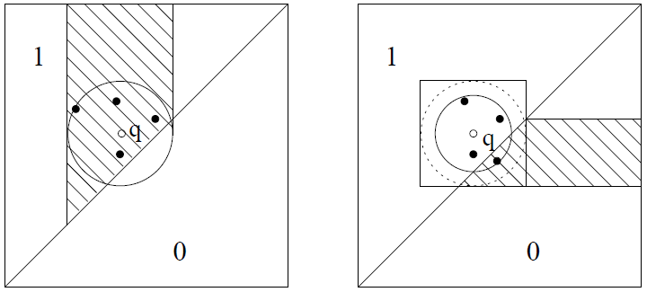
iMinMaxKNN Illustration
Simple example with k = 4 and θ = -1.

Slide 4
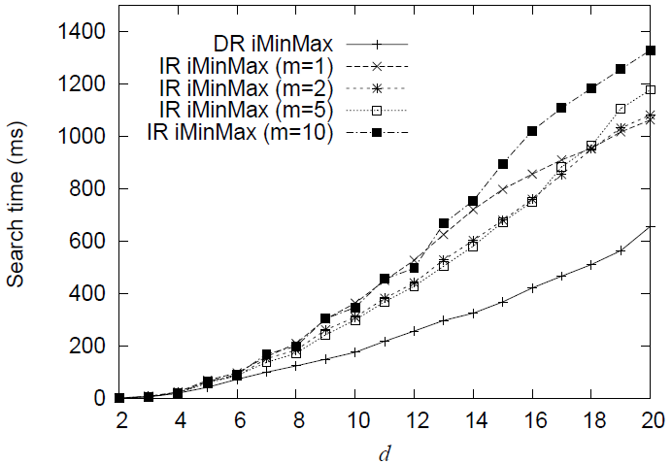
Increasing vs. Decreasing Radius
θ = 0, n = 1,000,000, and k = 10.

Slide 5
iMinMax Implementation Progress
Larry Lynn
Liessman Sturlaugson
Cole Schock

Slide 6
Development Environment
Source code repository
git version 1.7.2.5
Gitosis for read and write access over SSH
http://edu.tyob.info/viewgit/

Slide 7
C++ Components
Command line options parser
Source: http://code.google.com/p/getoptpp/
Author: Daniel Gutson
CSV parser
Source: http://stackoverflow.com/questions/415515/how-can-i-read-and-manipulate-csv-file-data-in-c
Author: Jonathan Leffler
iMinMax index creation

